Slide 1
Professur für Energiewandlungstechnik
TUM School of Engineering and Design
Technische Universität München
Research Internship
The Heat Equation Ovevrview
Ozan Aktürk
Munich, 24. February 2025
Supervisor: Sebastian Straßer, M.Sc

Slide 2
Content
The problem declaration
A known solution
Problem with the bachelor thesis
Conclusion

Slide 3
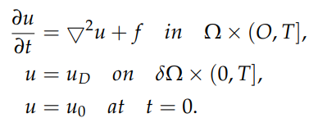
The problem declaration

Slide 4




A known solution

Slide 5
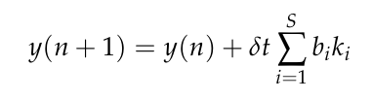
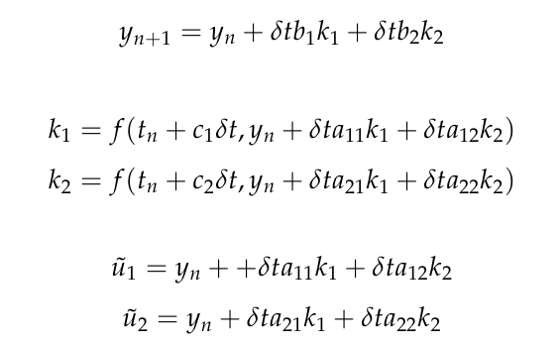
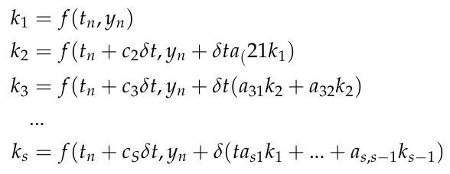
Problem with the bachelor thesis
Page 10
Page 26

Slide 6
Conclusion
There are some inconsistencies in the thesis.
My idea is to take
the repository from the thesis and
the known solution code from the tutorial
as my references.
The boundary condition taken into account for the multi-stage trial functions ki is the time derivative of u_D.
The reasoning is not explained.

Slide 7
Reference
[1] Wullenweber, N. (2021). High-order time stepping schemes for solving partial differential equations with FEniCS. https://mediatum.ub.tum.de/node?id=1621360
[2] P. E. Farrell, R. C. Kirby, and J. Marchena-Menendez, Irksome: Automating Runge–Kutta time-stepping for finite element methods., 2020
[3] Our previous meeting notes.

